Slide 1
Resume Workshop
Hoyt Library

Slide 2
Agenda
Resume Tips and Trends
The Sections of a Resume
Formatting with Word
Resources

Slide 3
Resume Tips and Trends
Keywords
Programmed headings
Simplicity & Consistency
Short lists, one to two lines
Similar colors, sizes, fonts, spacing

Slide 4
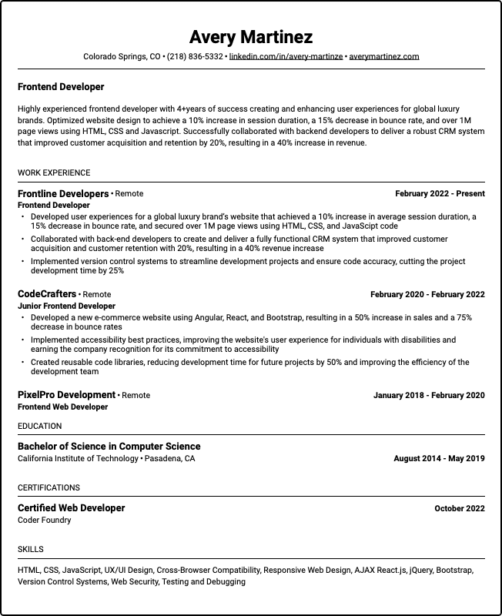
Sections of a Resume
Contact Information
Work Experience
Education
Certifications
Skills

Slide 5
Contact Information

Slide 6
Contact Information
Name
Location
Phone Number
Professional Links

Slide 7
Work Experience

Slide 8
Work Experience
Name of workplace
Name of position
Location
Date started – Date Ended
List of responsibilities

Slide 9
Highest level of education

Slide 10
Highest level of education
Diploma/Degree name
School name
Location
Date Started – Date Graduated

Slide 11
Certifications

Slide 12
Certifications
Name of certification
Name of provider
Date completed

Slide 13
Skills

Slide 14
Formatting With Word
Changing font style
Programming Headers
Bullets
Lines
Alignment

Slide 15
Resources
Use the “Build Your Resume” Tool through the LearningExpress Library with a MeL account
Search for resume templates online
300+ Resume Skills to Use on Your Resume in 2024
https://enhancv.com/resume-skills/
Ask AI, like ChatGPT
“List skills I could put on my resume from my job as a [your position]”

